Slide 1

Exploratory Data Analysis
G2M Insight for Cab Investment
November 16, 2022

Slide 2

Agenda
Executive Summary
Problem Statement
Approach
EDA
EDA Summary
Recommendations

Slide 3
Executive Summary
Background: XYZ is a private equity firm in the U.S. Due to remarkable growth in the Cab Industry in last few years and multiple key players in the market, it is planning for an investment in the Cab industry.
Problem Statement: Provide actionable insights to help XYZ firm in identifying the right company to invest in.
The Analysis can be broken down into four parts:
Approach to understanding the date
Exploratory data analysis results
Exploratory data analysis summaries
Recommendations

Slide 4
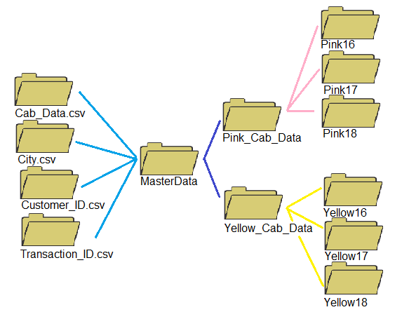
Approach
17 total features (not including derived features)
Timeframe of the data: Jan. 31, 2016, to Dec. 12, 2018.
Total data points: 359,352
Assumptions:
Profit was calculated by only considering Price_Charged and Cost_of_Trip
There were outliers in the dataset that was considered and not removed for analysis
The mean was used overthe median for-profit analysis despite outlier presence due to the low number of outliers

Slide 5
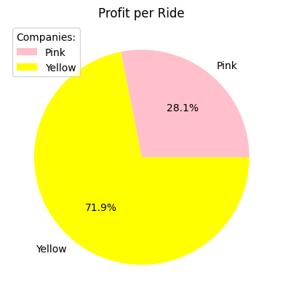
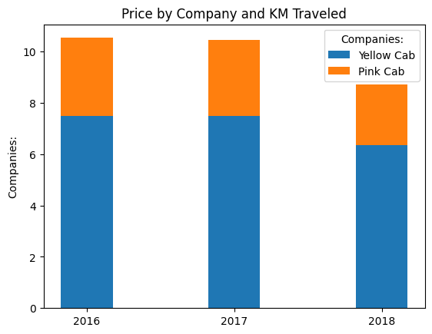

Profit Analysis

Slide 6
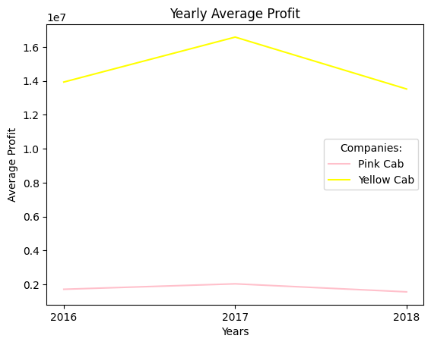
Profit Analysis
Both Companies experienced an increase in profit from 2016-2017 and a decrease from 2017-2018
Yellow Cab makes more profit than Pink Cab by nearly 7x

Slide 7
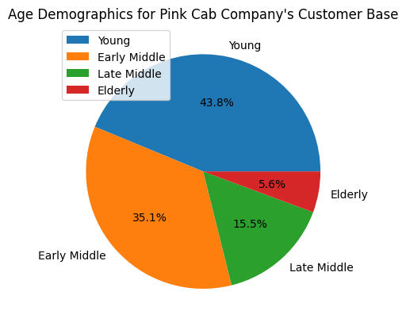
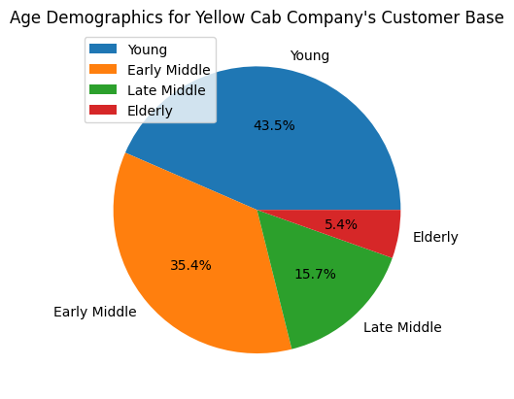
Age Analysis
Customer base for both companies are roughly the same with no considerably differences.

Slide 8
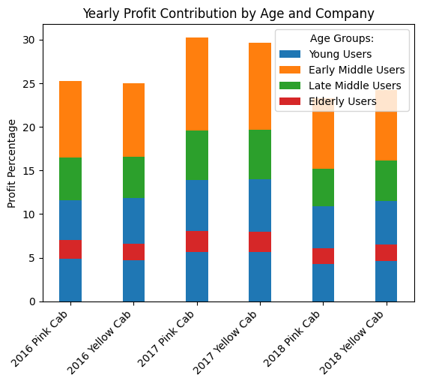
Age Analysis
There is a direct relationship between age demographic contribution and profit contribution with higher customer base percentage groups contributing more to yearly profit for both companies
Age Categories:
Young: 30-
Early Middle: 31 - 45
Late Middle: 46 - 60
Elderly: 60+

Slide 9
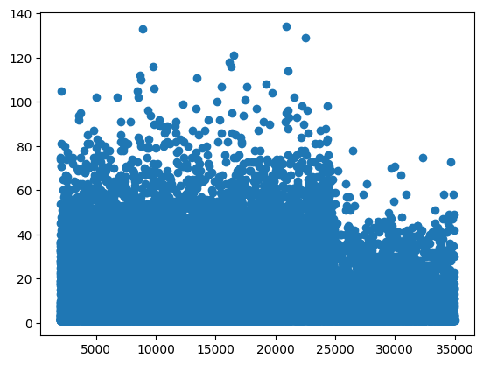
Income Analysis
Income Categories:
Working Class: 12,000-
Lower Middle Class: 12,000-20,000
Upper Middle Class: 20,000-30,000
Upper Class: 30,000+
Skewness: 0.31
Signifies that lower income classes tends to use taxi services the most out of all income categories
Warning: Income categories are scaled to fit the data and are not accurately associated with realized income ranged currently in America. Therefore, take extreme caution when applying these results to real-world applications

Slide 10
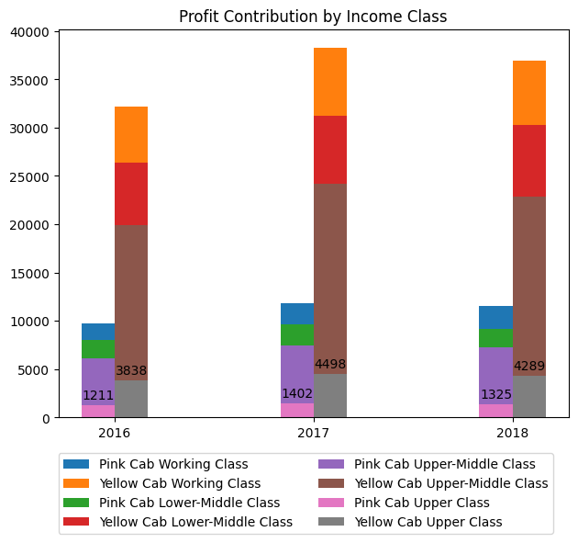
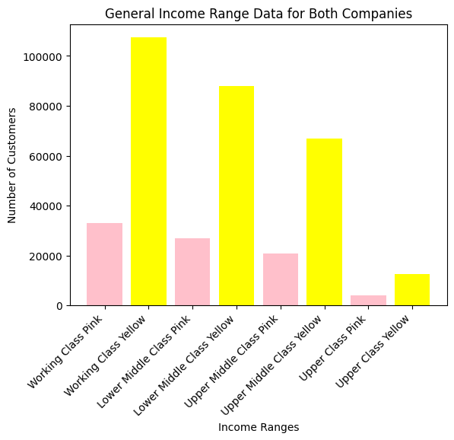
Income Analysis

Slide 11
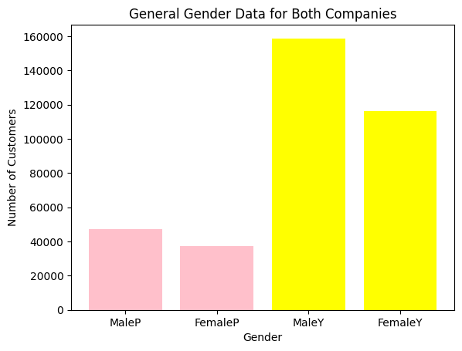
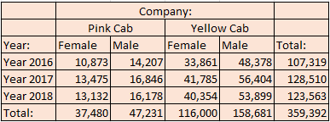
Gender Analysis
For both companies, males outnumber females in customer base
Males therefore also contribute more to profit for both companies
Looking at the chart, customers increased ~20% from 2016 to 2017 but increased ~4% when evaluating both companies

Slide 12
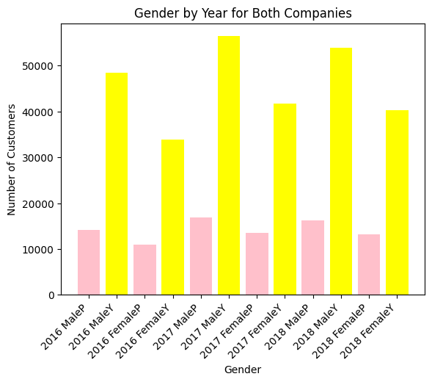
Gender Analysis
It is to be noted that further visualization concerning profit contribution by gender could have been conducted
Further, customer base by gender could have been represented as a percentage

Slide 13
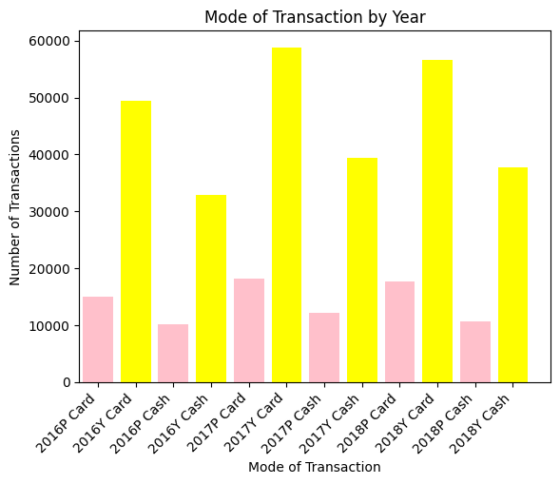
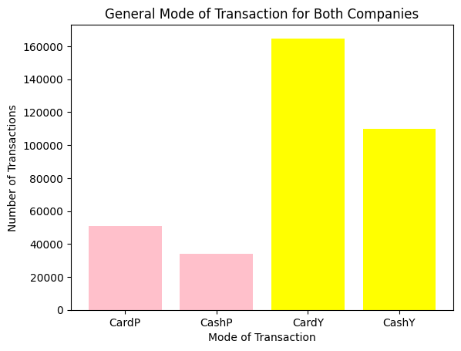
Payment Type Analysis

Slide 14
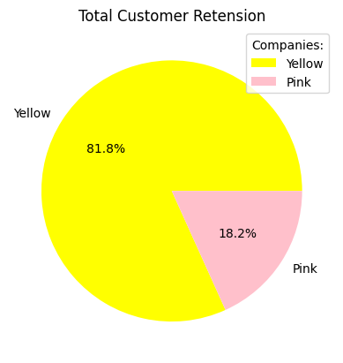
Customer Retention
Defined as the number of customers who have used the same cab services more than once
Yellow Cab charges more per ride and kilo but retains a higher customer base and most likely minimizes more costs at a higher scale than Pink Cab.

Slide 15
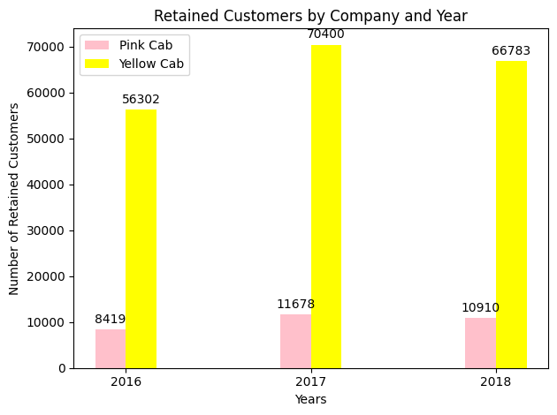
Customer Retention
Yearly retained customer defined as the number of customers who have used the same cab services more than once within a year

Slide 16
Recommendations:
Customer retention: Yellow Cab has more than 4x the number of customers who have used their services more than once than Pink Cab. This is true overall and looking at the individual year.
Age-Wise: Both companies appear to have very similar age demographics with young to early middle customers using the services and therefore contributing to most of the profits. There is not much remarkable differences to comment on. It is recommended that companies should focus on drawing in customers from the older range to get an edge.
Average Profit per Ride and per KM: Yellow Cab company outperforms their rival in profit earned per ride and per KM, earning up to 3x Pink Cab's respective amount.
Income-wise: Both companies have similar customer demographics income wise. Yellow Cab seems to have a slight edge over Pink in terms of reaching to all income classes. It is recommended that the companies focus on appealing to upper class to increase their profit % from this demographic to get an edge.
Transaction mode: Both companies' customers prefer card over cash, and it is recommended that the companies invest in user friendly electronic payment methods that is also secure to fit the growing usage of cards.
Gender: Yellow Cab customer base differs slightly from Pink's as Pink has a little bit higher reach with the female demographic. However, this is not detrimental to Yellow Cab's business as males overall contribute more profit than females. It is recommended Yellow Cab focuses on reaching out to the female demographic to gain a competitive edge over Pink Cab.
All things considered; Yellow Cab will be recommended for investment.

Slide 17
Thank You

